Slide 1
Climate Change: A visual through environmental shifts
Duy Mai
Hoang-Uyen Tran
Twan Tran
CECS 450 – Data Visualization

Slide 2
Where do we get our data?
Global Carbon Atlas
Our World in Data
World Bank Open Data
Carbon Brief
IMF

Slide 3
Tools and Technologies
Programming language: Python
Libraries: Pandas, NumPy, Matpolib, Ploty, Seaborn.

Slide 4
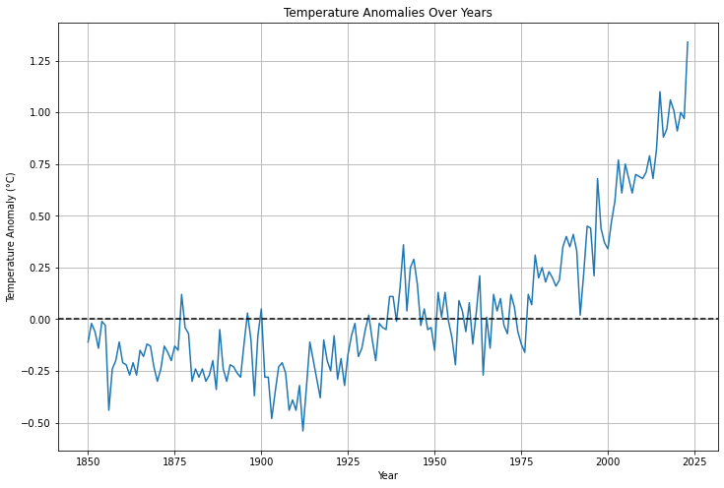
WHAT IS CLIMATE CHANGE?
Climate change, often referred to as global warming, or the greenhouse effect, is a change in the Earth's average temperature and cycles of weather patterns caused by human activities over a long period of time.
These have been recorded since 1850 in various parts of the world by means of thermometer-based records. There is a clear upward trend in terms of temperature data across the globe suggesting warming trend.
The rising temperatures represent an evident sign of climate change.
Notes:
Right now we are at 1.5 C

Slide 5
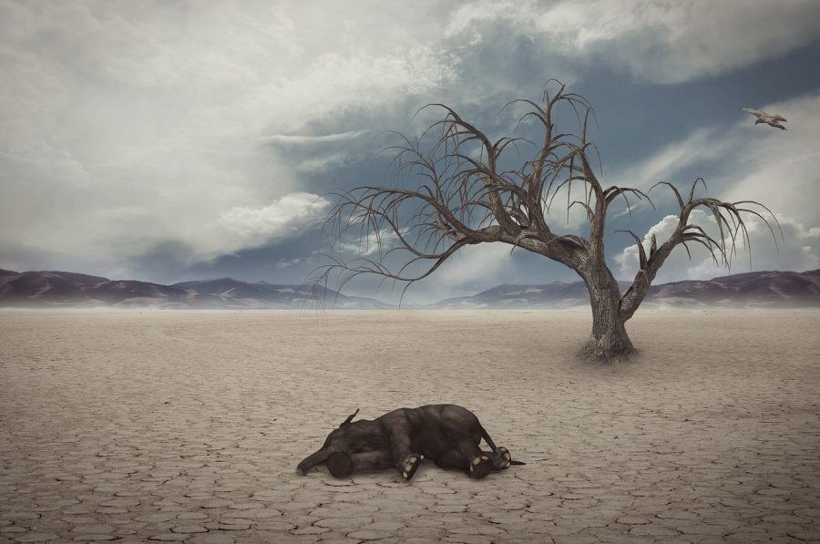
WHY IS IT A PROBLEM?
Over a long period of time species adapt gradually to fit well with their environment. This is supported by a stable climate that facilitates growth and adaptation of life. But rapid climate changes present a challenge: this implies that, organism has very short time for adaptation. Such rapid changes may sometimes prove hard for certain species to adapt with and consequently threaten them existence in a new surroundings.

Slide 6
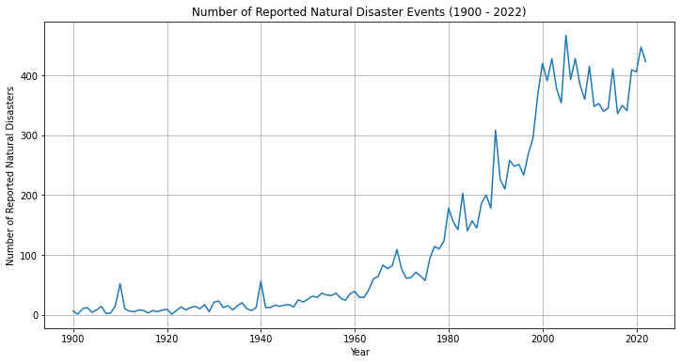
Why is It a problem?
Changes in climate cause different types of weather and more frequent extreme weather patterns. Such changes involve rising in the number of hurricanes, prolonged droughts, and more severe flooding.
However, at the same time, one should take into account an association between increasing average temperatures around the world and rising numbers of witnessed natural disasters.

Slide 7
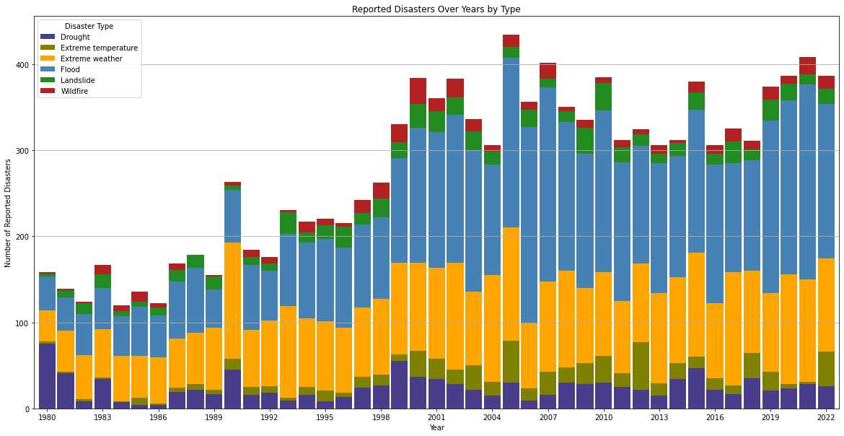
The frequency of various types of disasters has increased for the last three decades, starting with year 1980. As the temperature keeps rising the amount of flooding, landslides, and even wildfire has increased significantly. Furthermore, there has been more extremes of wind, heat and drought than used to be in times past.
Why is It a problem?

Slide 8
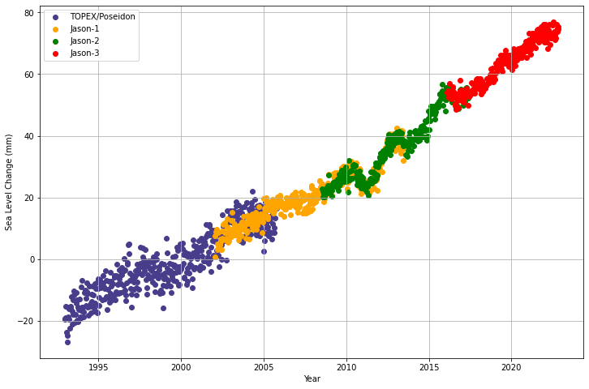
WHY IS IT A PROBLEM?
Sea levels are rising as a result of increasing temperatures.
Over time, this can lead to high tides that flood coastal areas and destroy habitats thereby relocating entire communities living in flatlands/low-lying areas.
Rising sea levels are driven by two main processes:
Ice Melt: Warming up of air and sea leads to melting of the ice sheets and glaciers, consequently adding salt-less water into sea water.
Thermal Expansion: The increase in sea levels can be attributed to increasing temperatures of ocean water that causes it to expand.

Slide 9
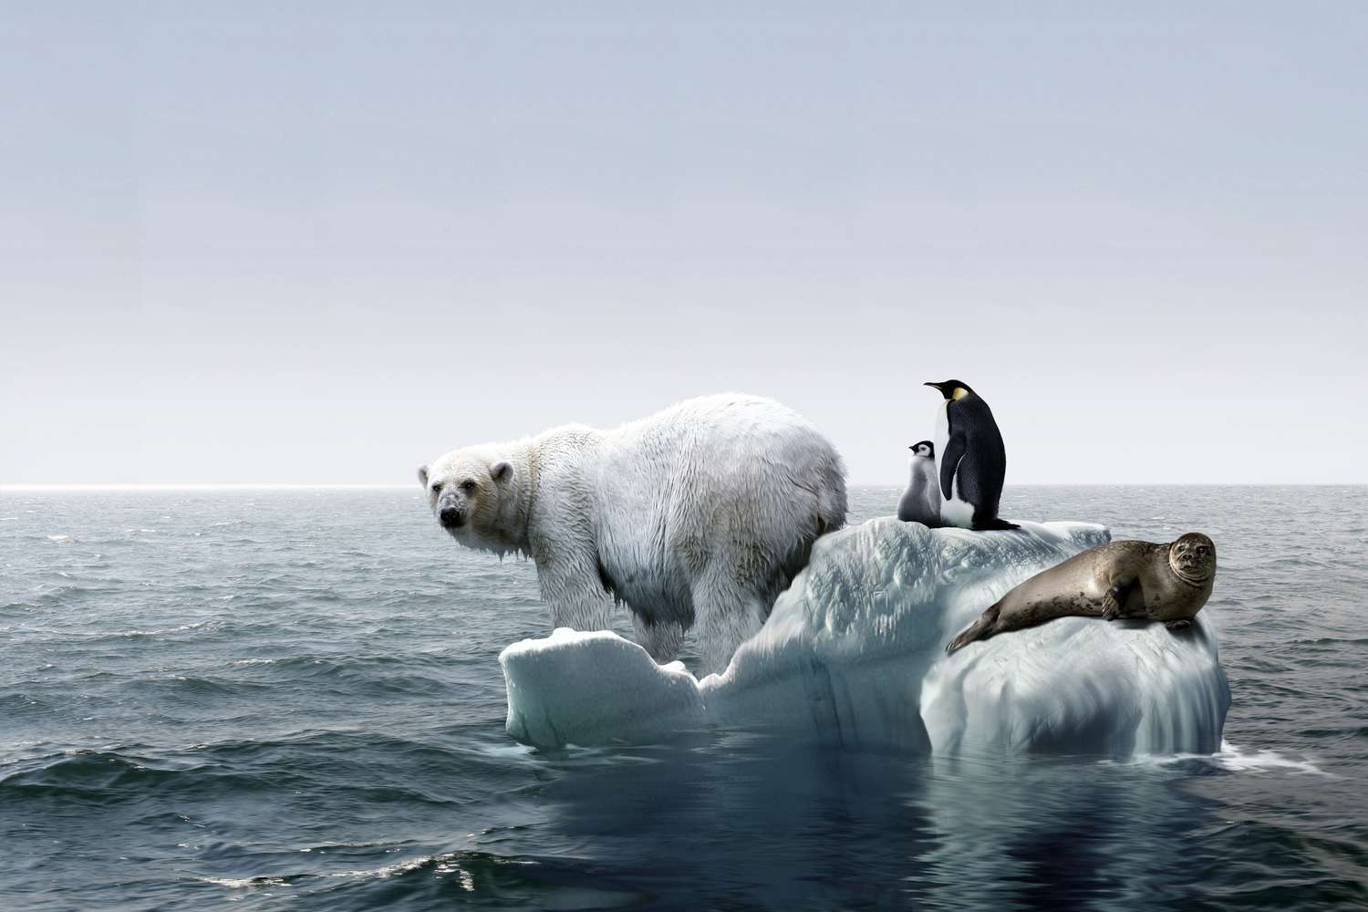
WHY IS IT A PROBLEM?
The retreat of sea ice caused by increasing global temperatures has reduced the area of ice where many polar mammals engage in vital pursuits such as feeding, mating, and resting. This change poses a lot of problems to creatures like polar bears and seals by messing up with their feeding grounds as well as the breeding zones. The declining of ice makes it difficult the animals to find food and place of breeding as a well the rest.

Slide 10
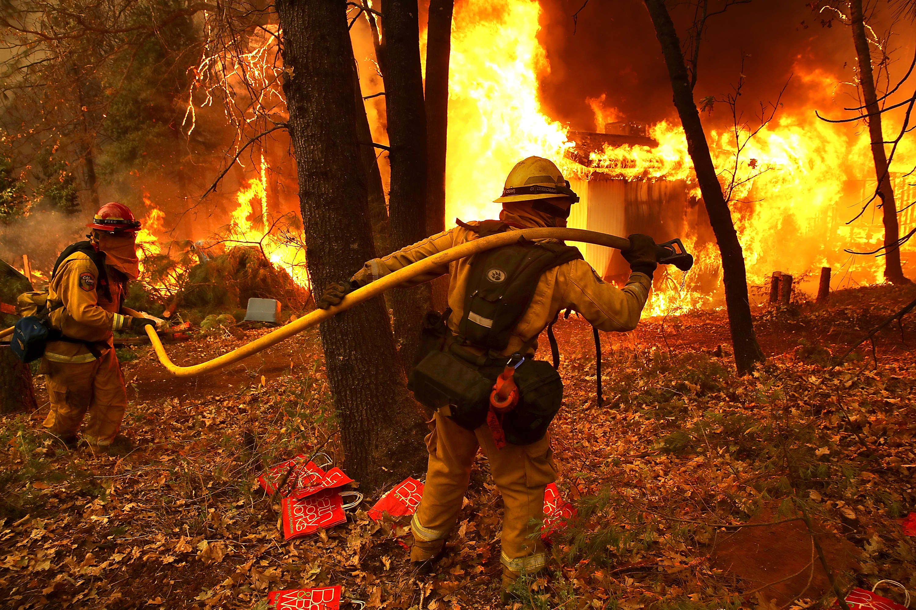
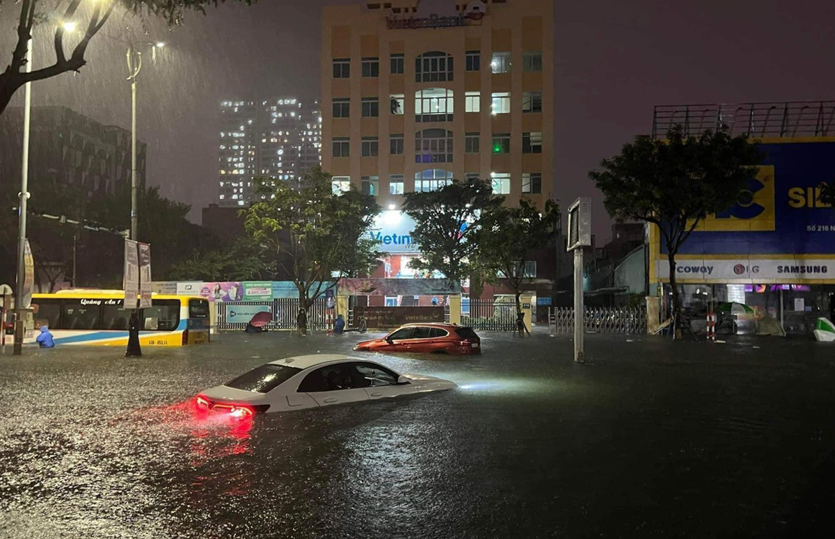
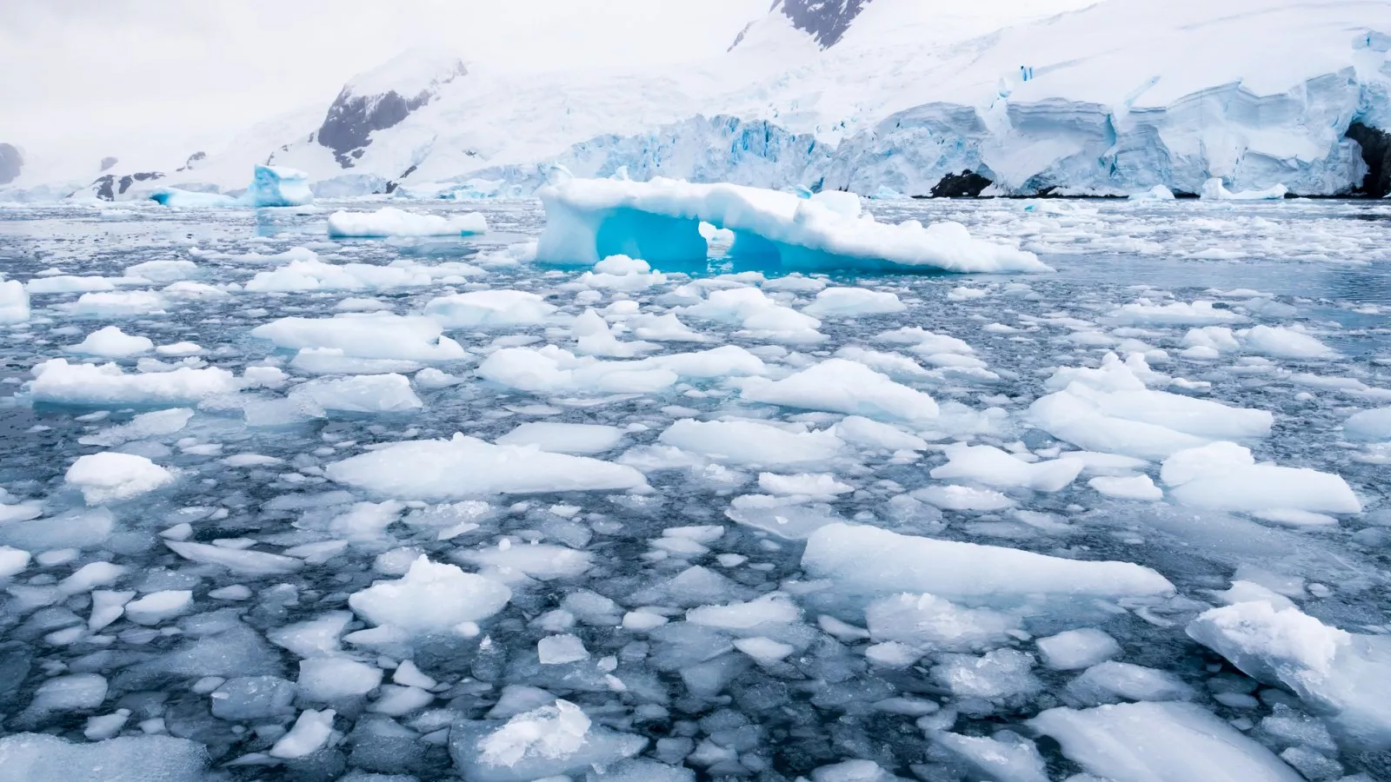
The temperature may continue going up even if we rush to take action due to the fact that the gases released into the atmosphere have made their effects known already. These issues that we already have will just become worse.
WHY IS IT A PROBLEM?
Wildfire that burn people house
Flooding paralyzes the traffic
Melting ice in Antarctica
We need to act fast to limit temperature increase as much as possible since it extremely important to for people and wildlife.
Do you think that a rise of 0.5ºC in global temperature will have any significant impact?

Slide 11
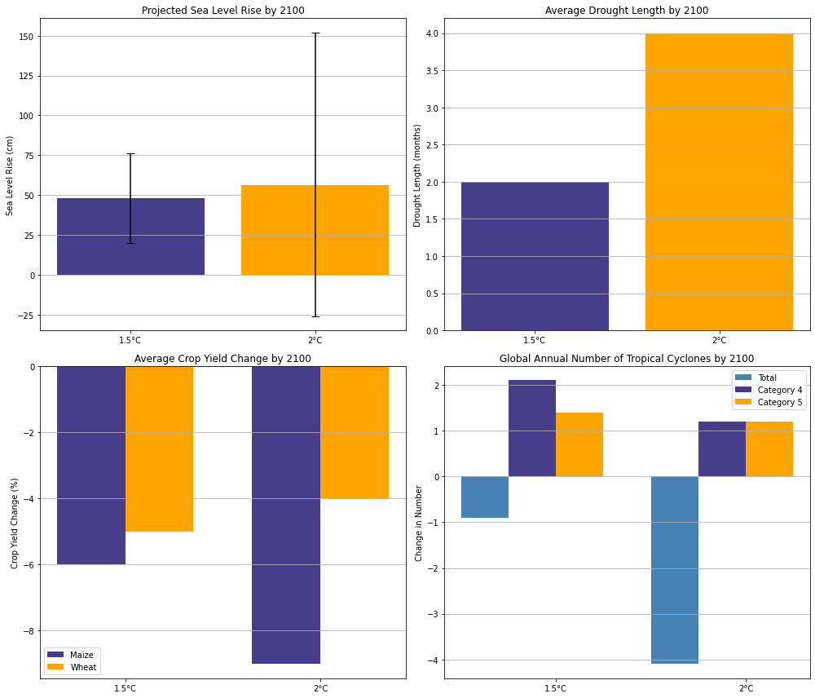
Why is It a problem?
By 2100, 0.5ºC will causes:
Sea level to rise up to 8mm
Increase the drought length up to 2 months
Reduce maize production by 3%.
Reduce annually the total number of tropical cyclones by about 3, but more frequent high category cyclone (category 4-5)

Slide 12
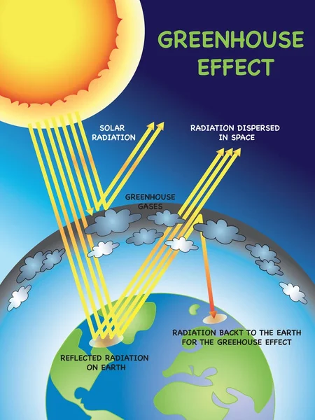
WHAT CAUSES CLIMATE CHANGE?
Greenhouse gases (GHGs) like CO2, CH4, and N2O are the primary cause.
GHGs create a blanket effect in the atmosphere, trapping heat.
Result: Earth's temperature increases.
Consequences: Extreme weather events, rising sea levels, and disruptions in ecosystems.

Slide 13
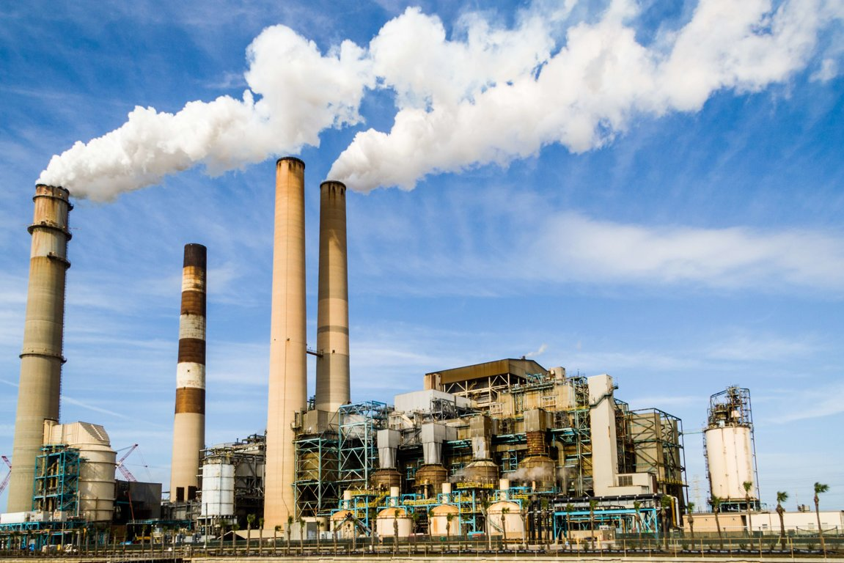
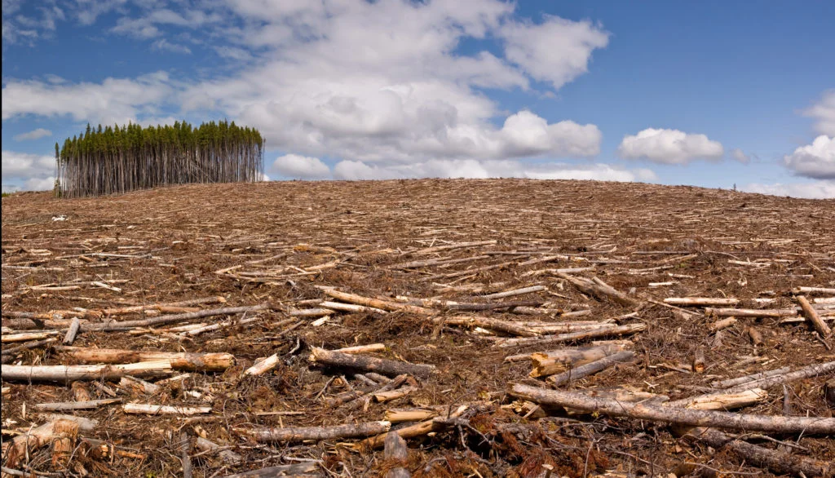
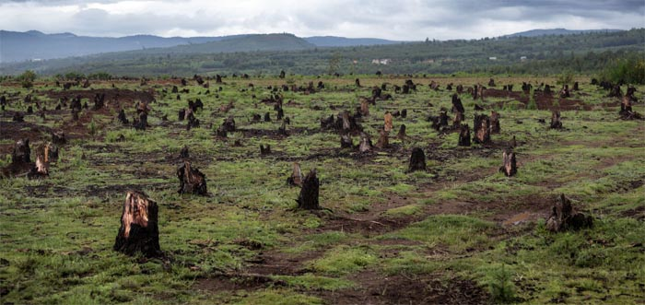
WHAT CAUSES CLIMATE CHANGE?
Climate change can be caused gradually by natural processes or suddenly by large events, such as a massive meteorite strike or volcanic activity. However, the rapid climate change we are experiencing now is due to three main human activities:
The use of fossil fuels like natural gas, oil and coal in heating and cooking; manufacture of electric and power generating units; motor engine operation creates carbon dioxide which is released into the atmosphere.
Carbon dioxide is released by deforestation (decomposing of forests), reducing the number of trees that can absorb carbon dioxide from the air.
Deterioration in biodiversity results to an erratic environment. Ecosystems become less efficient in absorbing carbon emissions as a result of nature loss, making them more susceptible to warming.

Slide 14
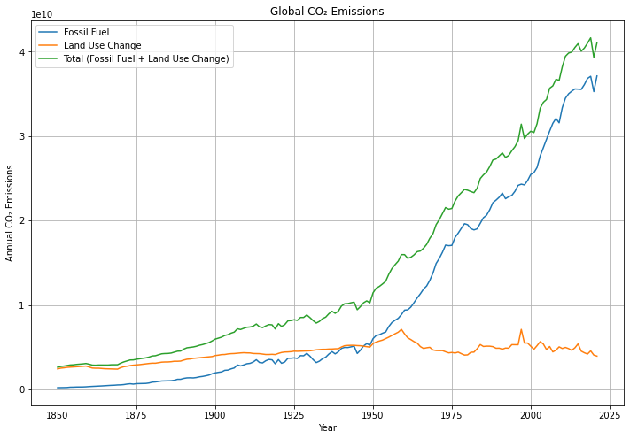
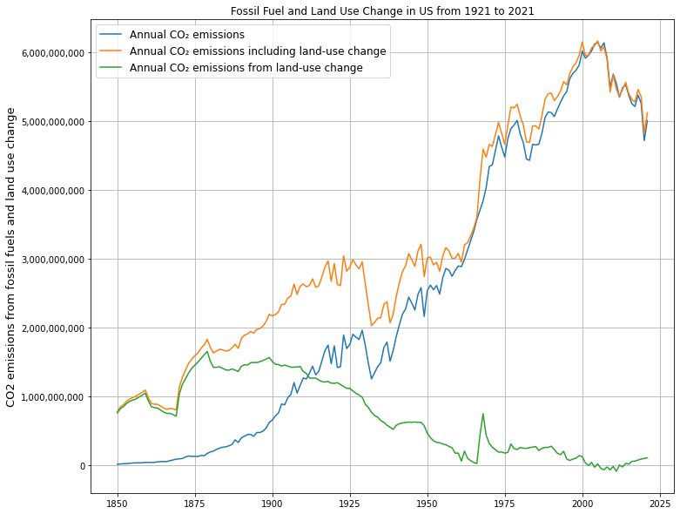
WHAT CAUSES CLIMATE CHANGE?

Slide 15
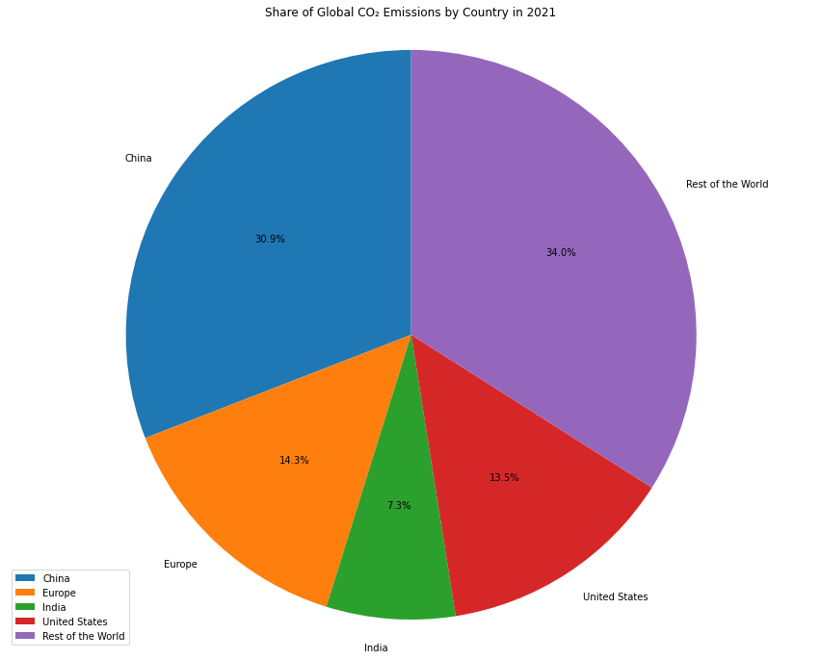
WHO CAUSES CLIMATE CHANGE?
It is estimated that around 1% of greenhouse gases in the question of global warming are said to originate from the 50 most less-developed countries. On the other hand, inputs by the U.S, EU, and China accumulate about 60% of the World’s CO2 Emission.

Slide 16
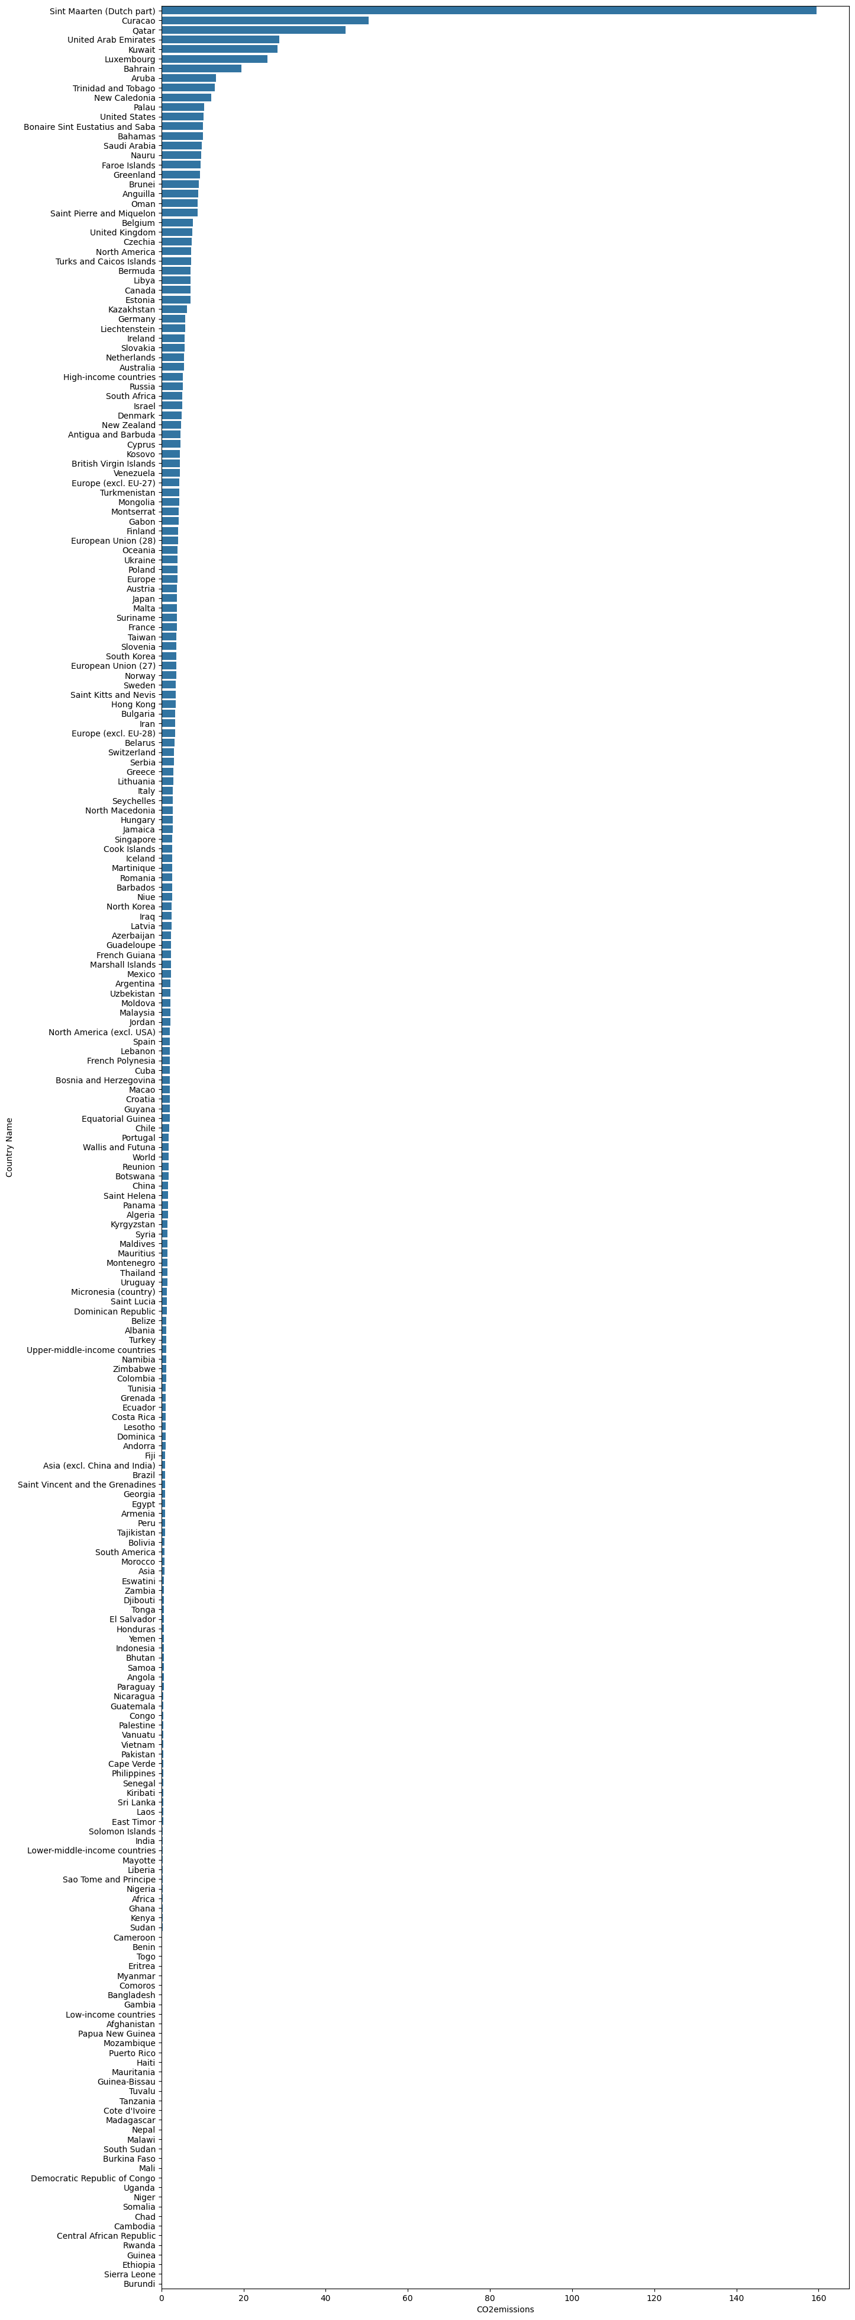
Largest Average CO2 Emissions Per Capita

Slide 17
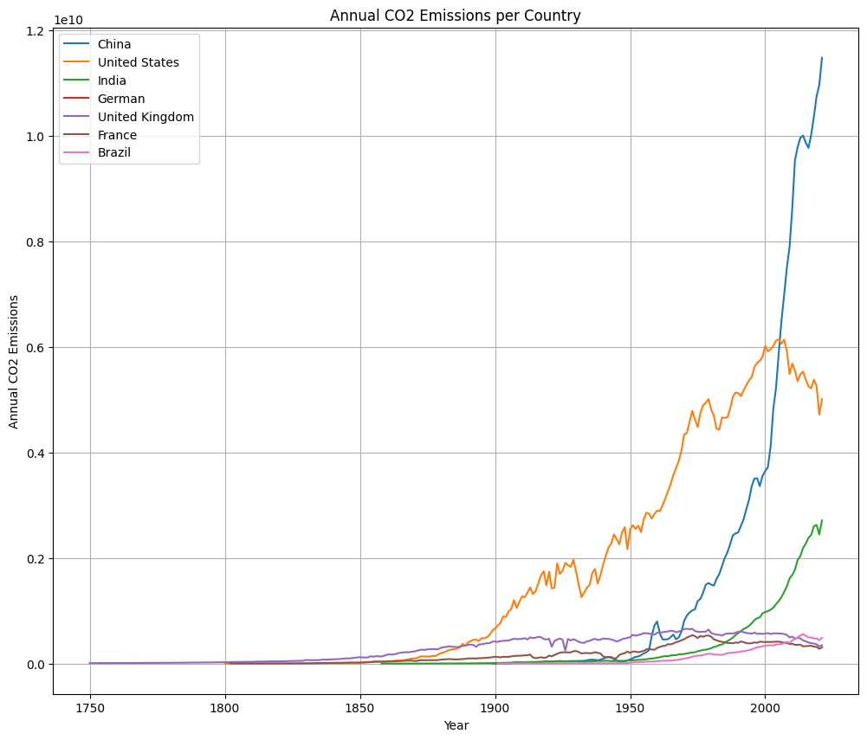
WHO DOES CLIMATE CHANGE AFFECT?
In the long term, climate change effects have the potential to affect everyone. However, at the moment, certain people and areas have an unequal share of its impact.
Rich nations have always made money from activities which cause global warming. Due to this financial benefit, these nations can shield themselves immediately from climatic changes’ impacts.
The poorest countries confront more difficult times to adapt, and they suffer the worst impacts associated with such changes in climate. Despite facing climate related adversities, their development is impeded by their limited resources and capacity due to this factor.
However, it is ironic that the countries most unaffected by the climate crisis suffer from it the most, implying an asymmetry between culpability and hardship.

Slide 18

Conclusion
Electrical Vehicle
Economy that reduces waste and recycling
Invest in technology that capture and store carbon
Shift from fossil fuels to renewable energy sources : solar

